Slide 1
Orchid fleck dichorhavirus: a new Brevipalpus transmitted virus fresh from Florida
A. Fife¹, D. Carrillo², G. Knox³, F. Iriarte⁴, K. Dey⁵, A. Roy⁶, R. Ochoa⁷, G. Bauchan⁸, M. Paret^{4,9}, X. Martini¹* ¹ University of Florida, Department of Entomology and Nematology, North Florida Research and Education Center, Quincy FL 32351 ² University of Florida, Department of Entomology and Nematology, Tropical Research and Education Center, Homestead FL 33031 ³ University of Florida, Department of Environmental Horticulture, North Florida Research and Education Center, Quincy FL 32351 ⁴ University of Florida, Department of Plant Pathology, North Florida Research and Education Center, Quincy FL 32351 ⁵ The Florida Department of Agriculture and Consumer Services, Division of Plant Industry, Section of Plant Pathology, Doyle Conner Building, 1911 SW 34th street, Gainesville, FL 32608 ⁶ United States Department of Agriculture – Agriculture Research Service, Molecular Plant Pathology Laboratory, 10300 Baltimore Ave, Bldg. 4 BARC-West, Beltsville, MD 20705 ⁷ United States Department of Agriculture - Agriculture Research Service, Systematic Entomology Laboratory 10300 Baltimore Ave, Bldg. 5 BARC-West, Beltsville, MD 20705 ⁸ United States Department of Agriculture - Animal and Plant Health Inspection Service, Electron and Confocal Microscopy Unit, Bldg. 12 BARC-West, 10300 Baltimore Ave, Beltsville, MD 20705 ⁹ Plant Pathology Department, University of Florida, Gainesville, FL 32611

Slide 2
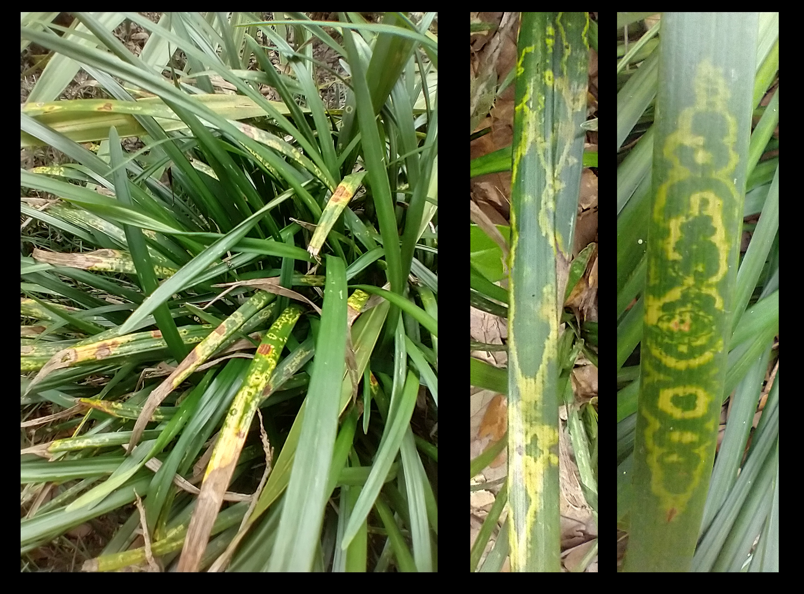
A visit to the Zoo

Slide 3
a

Slide 4
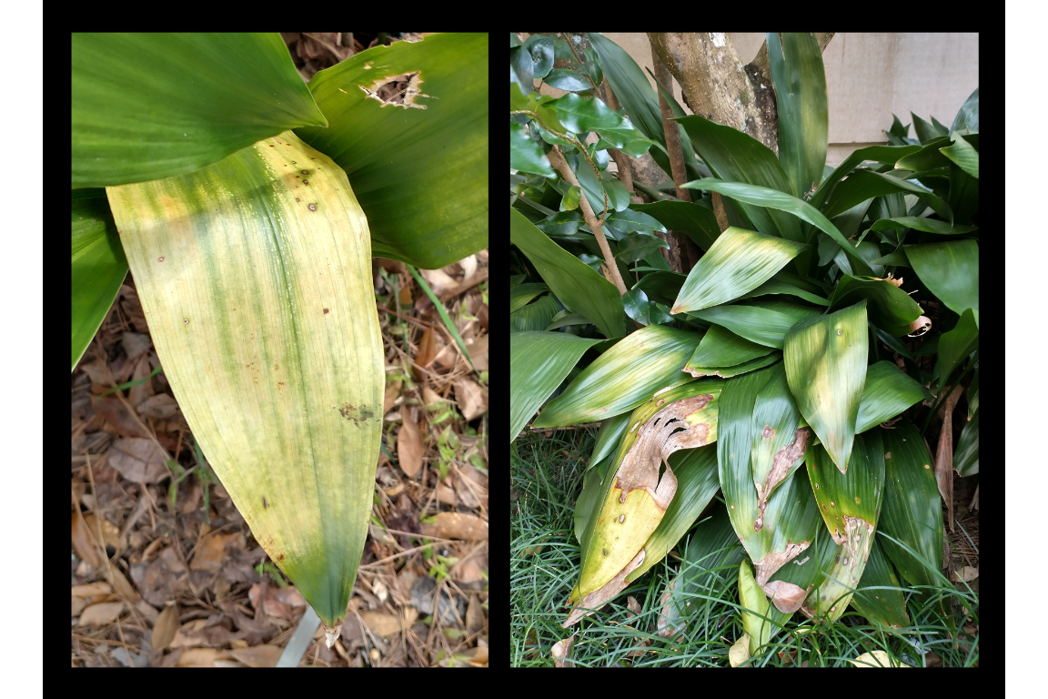
a

Slide 5
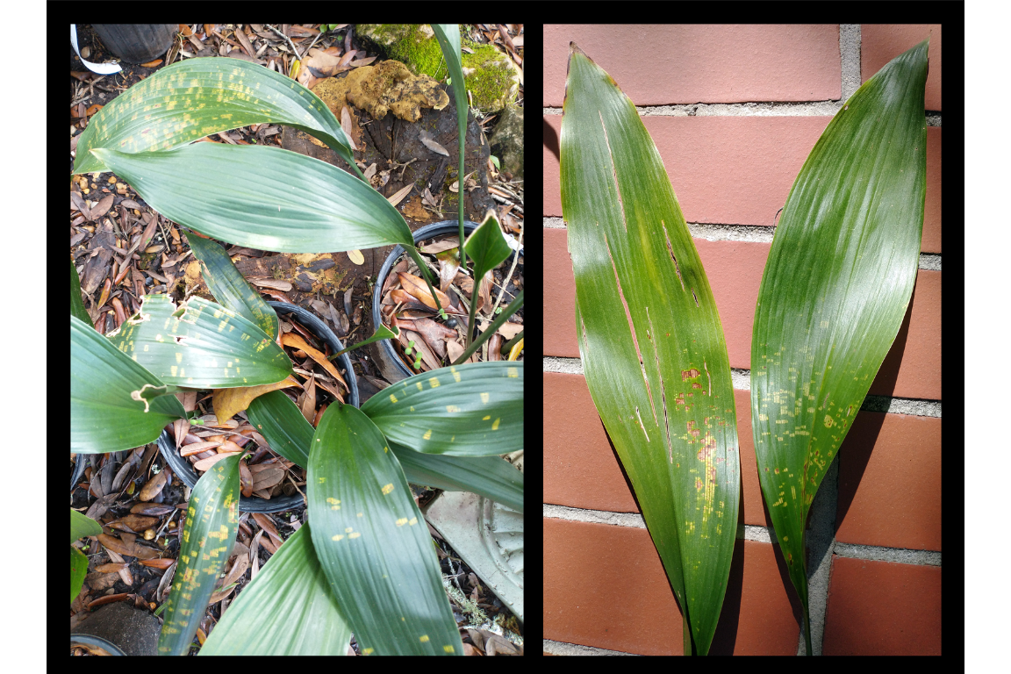
a

Slide 6
Intro
During June 2020, chlorotic ringspot symptoms on Giant Lilyturf (Liriope spp., cv. ‘Gigantea’) were observed in a landscape in Leon County, Florida. - Initially tested at the Plant Disease Diagnostic Clinic at the North Florida Research and Education Center (NFREC) in Quincy, FL - Tested negative for begomovirus, potyvirus, tospovirus as well as for Impatiens necrotic spot virus, Tobacco mosaic virus and Tomato spotted wilt virus - Sent to the Florida Department of Agriculture and Consumer Services (FDACS)

Slide 7
OFV Confirmation
Identified using OFV specific conventional reverse transcription polymerase chain assay (RT-PCR) assay + Sanger sequencing + quantitative RT-PCR (RT-qPCR)
Presence of Orchid fleck dichorhavirus confirmed using OFV generic R2-Dicho-GF and R2-Dicho-GR primers (Roy et al. 2020)
Sanger sequencing of RT-PCR amplicons shared 98% nucleotide identity with orchid strains of OFV: OFV-Orc1 and OFV-Orc2 (GenBank Accession numbers: AB244418 and LC222630) (Kondo et al. 2006, 2017).

Slide 8
Orchid fleck virus (OFV)
Type member for the genus Dichorhavirus, family Rhabdoviridae
Citrus chlorotic spot virus, Citrus leprosis virus N, Clerodendrum chlorotic spot virus and Coffee ringspot virus
Infects 50+ plant species, including Orchidaceae, Asparagaceae (Nolinoidaea), and Rutaceae (Citrus)
Flat mites from the genus Brevipalpus Donnadieu (Trombidiformes: Tenuipalpidae) only known vectors of dichorhaviruses

Slide 9
Distribution of OFV
first described infecting Cymbidium orchids in Japan (Doi et al. 1977)
OFV and OFV-like rhabdoviruses have been reported from
Asia: [China (Peng et al. 2017), Korea Zheng et al. (2013)]
Africa: [South Africa (Cook et al. 2019)]
North America: [The United States (Blanchfield et al. 2001, Bratsch et al. 2015), Mexico (Otero-Colina et al. 2021)]
South America: [Brazil (Kitajima et al. 1974, Kitajima et al. 2001), Colombia (Kubo et al. 2009), Costa Rica (Freitas-Astúa et al. 2002), Paraguay (Ramos-González et al. 2015)]
Europe: [Denmark (Begtrup 1972), France (Sauvêtre et al. 2018), Germany (Petzold 1971, Lesemann and Doraiswamy 1975)]
Oceania: [Australia (Lesemann and Begtrup 1971, Lesemann and Doraiswamy 1975, Gibbs 2000), Fiji (Pearson et al. 1993), Vanuatu (Pearson et al. 1993)]
Prevalence of OFV and its mite vector is thought to be associated with the movement of infected orchids (Dietzgen et al. 2018)

Slide 10
Further Surveys
Additional samples were taken from other Nolinoidaea, including Liriope muscari, Ophiopogon japonicus, O. intermedius and Aspidistra elatior Blume (Asparagaceae: Nolinoidaea) in Leon and Alachua counties.

Slide 11
Mites Recovered
Three Brevipalpus mite species were recovered from OFV-infected plants:
Brevipalpus californicus sensu lato
B. obovatus Donnadieu
B. confusus Banks
One of these species is presumably responsible for OFV transmission
Brevipalpus californicus (Banks) group are the only known to transmit OFV in a persistent propagative manner
Brevipalpus mite species complex contains cryptic species (Childers and Rodrigues 2011)

Slide 12
Conclusions
The dichorhavirus that infects citrus in Hawaii, Mexico, Colombia, and South Africa are identical to the OFV in gene order, content, and the genome sequence. According to the International committee on Taxonomy of Viruses (ICTV) classification, OFV consist of two orchid strains (OFV-Orc1 and OFV-Orc2) and two citrus strains (OFV-Cit1 and OFV-Cit2). Both the orchid strains of OFV infects citrus (Roy et al. 2020), but none of the citrus strains have been reported from any orchid species. Detecting OFV in Florida represents a concern for horticulturists who grow orchids, Liriope, Ophiopogon, or other susceptible Asparagaceae species which are commonly used in landscaping. Florida is also home to a plethora of native and naturalized orchid species, many of which are threatened, including cultivating Vanilla in southern Florida (Chambers et al. 2019) and the famous Ghost Orchid, [Dendrophylax lindenii (Lindl.) Benth. ex Rolfe]. Citrus leprosis was present in Florida during the 1860’s and eradicated in the mid-1960s. In fact, Kitajima et al. (2011) found that the Citrus Leprosis virus (CiLV) which previously affected Florida citrus was a nuclear type of citrus leprosis closely related to OFV strains (Roy et al. 2013). Association of a distant relative of OFV named Citrus leprosis dichorhavirus-N0 (CiLV-N0) was confirmed in relation to the leprosis disease outbreak in Florida (Hartung et al. 2015). The recent detection of OFV-Orc1 in South Africa (Cook et al. 2019) in C. sinensis (Navel and Valencia orange) and OFV-Orc2 in Hawaii (Velarde et al. 2021) in C. reticulata (mandarin) and C. jambhiri (rough lemon) highlights the threat of different strains of OFV; which will be a definite concern to the multi-billion dollar citrus industry. Lastly, some OFV isolates are known to be involved with citrus leprosis disease in Mexico (Roy et al. 2015), which is a cause for concern for the citrus industry. B. californicus and B. yothersi are both known vectors of Dichorhaviruses (OFV) and Cileviruses (Citrus Leprosis) (Knorr 1968, Kondo et al. 2003, Beltran-Beltran et al. 2020) and B. obovatus is a suspected vector as well (Childers et al. 2003). All three mite species/complexes are present in Florida (Childers et al. 2003, Akyazi et al. 2017) (Fig. 1). Therefore, it is critical to identify the vector of OFVs in Florida and monitor its spread to determine the risk this virus represents for the native plants, agriculture and the ornamental/landscaping industries of Florida and the surrounding regions.

Slide 13
Risk to Florida
Florida has various mite species of Brevipalpus
Diverse array of susceptible native and introduced plant species in the landscape
OFV already has a wide distribution in Florida which will continue to spread if unchecked
Represents a threat for Liriope spp., Ophiopogon spp. and Aspidistra elatior $→$ most important ground covers in southeastern US (Mcharo et al. 2003)

Slide 14
Take home and future need for study
Three new hosts from the family Asperagaceae
Need to know the extended host range of OFVs
Survey of Florida’s citrus growing regions, esp. plants within the families Rutaceae and Asparagaceae
Mite species determination: PCR methods?
Mite transmission assays

Slide 15
Acknowledgements
We would like to give a special thanks to the Tallahassee Museum for their patience, cooperation, and support with collecting plant samples. We also want to thank Drs. Sam Bolton, FDACS and Aline Tassi, Univ. of Sao Paulo, Brazil for checking the mites we have sent for species validation. We are especially indebted to the late Dr. Gary Bauchan for his contributions to this study and the field of acarology, he will be greatly missed. This research was partly funded by the USDA National Institute of Food and Agriculture, Hatch project FLA-NFC-005607. Mention of trade names or commercial products in this publication is solely for the purpose of providing specific information and does not imply recommendation or endorsement by the USDA; USDA is an equal opportunity provider and employer.

Slide 16
References
Akyazi, R., E. A. Ueckermann, and O. E. Liburd. 2017. New report of Brevipalpus yothersi (prostigmata: Tenuipalpidae) on blueberry in Florida. Florida Entomologist. 100: 731–739.
Begtrup, J. 1972. Structure of a bacilliform virus in Dendrobium as revealed by negative staining. Journal of Phytopathology. 75: 268–273.
Beltran-Beltran, A. K., M. T. Santillán-Galicia, A. W. Guzmán-Franco, D. Teliz-Ortiz, M. A. Gutiérrez-Espinoza, F. Romero-Rosales, and P. L. Robles-Garcı́a. 2020. Incidence of citrus leprosis virus c and orchid fleck dichorhavirus citrus strain in mites of the genus Brevipalpus in Mexico. Journal of Economic Entomology. 113: 1576–1581.
Blanchfield, A. L., A. M. Mackenzie, A. Gibbs, H. Kondo, T. Tamada, and C. R. Wilson. 2001. Identification of orchid fleck virus by reverse transcriptase-polymerase chain reaction and analysis of isolate relationships. Journal of Phytopathology. 149: 713–718.
Bratsch, S. A., B. E. Lockhart, and C. Ishimaru. 2015. Confirmation of first report of orchid fleck virus in phalaenopsis hybrid orchids in the USA. Plant Health Progress. 16: 146–148.
Chambers, A. H., P. Moon, V. Edmond, and E. Bassil. 2019. Vanilla cultivation in southern Florida. EDIS. 2019: 7.
Chang, M. U. 1991. Studies on the viruses in orchids in Korea. 2. Dendrobium mosaic virus, Odontoglossum ringspot virus, Orchid fleck virus and unidentified potyvirus. Korean J Plant Pathol. 7: 118–129.
Childers, C. C., and J. C. V. Rodrigues. 2011. An overview of Brevipalpus (acari: Tenuipalpidae) and the plant viruses they transmit. Zoosymposia. 6: 180–192.
Childers, C. C., J. C. V. Rodrigues, K. S. Derrick, D. S. Achor, J. V. French, W. C. Welbourn, R. Ochoa, and E. W. Kitajima. 2003. Citrus leprosis and its status in Florida and Texas: Past and present. Experimental and Applied Acarology. 30: 181–202.
Cook, G., W. Kirkman, R. Clase, C. Steyn, E. Basson, P. H. Fourie, S. D. Moore, T. G. Grout, E. Carstens, and V. Hattingh. 2019. Orchid fleck virus associated with the first case of citrus leprosis-N in South Africa. European Journal of Plant Pathology. 155: 1373–1379.
Dietzgen, R. G., J. Freitas-Astúa, C. Chabi-Jesus, P. L. Ramos-González, M. M. Goodin, H. Kondo, A. D. Tassi, and E. W. Kitajima. 2018. Dichorhaviruses in their host plants and mite vectors, pp. 119–148. In Advances in Virus Research. Elsevier.
Doi, Y., M. U. Chang, and K. Yora. 1977. Orchid fleck virus. CMI/AAB descriptions of plant viruses.
Freitas-Astúa, J., L. Moreira, C. Rivera, C. M. Rodrı́guez, and E. W. Kitajima. 2002. First report of orchid fleck virus in Costa Rica. Plant Disease. 86: 1402–1402.
Gibbs, A. 2000. Viruses of orchids in Australia; their identification, biology and control. The Australian Orchid Rev. 65: 10–21.
Hartung, J. S., A. Roy, S. Fu, J. Shao, W. L. Schneider, and R. H. Brlansky. 2015. History and diversity of citrus leprosis virus recorded in herbarium specimens. Phytopathology. 105: 1277–1284.
Kitajima, E. W., A. Blumenschein, and A. S. Costa. 1974. Rodlike particles associated with ringspot symptoms in several orchid species in Brazil. Journal of Phytopathology. 81: 280–286.
Kitajima, E. W., C. M. Chagas, M. T. Braghini, L. C. Fazuoli, E. C. Locali-Fabris, and R. B. Salaroli. 2011. Natural infection of several Coffea species and hybrids and psilanthus ebracteolatus by the coffee ringspot virus (CoRSV). Scientia Agricola. 68: 503–507.
Kitajima, E. W., H. Kondo, A. Mackenzie, J. A. M. Rezende, R. Gioria, A. Gibbs, and T. Tamada. 2001. Comparative cytopathology and immunocytochemistry of Japanese, Australian and Brazilian isolates of orchid fleck virus. Journal of General Plant Pathology. 67: 231–237.
Knorr, L. C. 1968. Studies on the etiology of leprosis in citrus. In International Organization of Citrus Virologists Conference Proceedings.
Kondo, H., K. Hirota, K. Maruyama, I. B. Andika, and N. Suzuki. 2017. A possible occurrence of genome reassortment among bipartite rhabdoviruses. Virology. 508: 18–25.
Kondo, H., T. Maeda, Y. Shirako, and T. Tamada. 2006. Orchid fleck virus is a rhabdovirus with an unusual bipartite genome. Journal of General Virology. 87: 2413–2421.
Kondo, H., T. Maeda, and T. Tamada. 2003. Orchid fleck virus: Brevipalpus californicus mite transmission, biological properties and genome structure. Experimental and Applied Acarology. 30: 215–223.
Kubo, K. S., J. Freitas-Astúa, M. A. Machado, and E. W. Kitajima. 2009. Orchid fleck symptoms may be caused naturally by two different viruses transmitted by Brevipalpus. Journal of General Plant Pathology. 75: 250–255.
Lesemann, D., and J. Begtrup. 1971. Elektronenmikroskopischer nachweis eines bazilliformen virus in Phalaenopsis. Journal of Phytopathology. 71: 257–269.
Lesemann, D., and S. Doraiswamy. 1975. Bullet-shaped virus-like particles in chlorotic and necrotic leaf lesions of orchids. Journal of Phytopathology. 83: 27–39.
Mcharo, M., E. Bush, D. L. Bonte, C. Broussard, and L. Urbatsch. 2003. Molecular and morphological investigation of ornamental liriopogons. Journal of the American Society for Horticultural Science. 128: 575–577.
Otero-Colina, G., P. L. Ramos-González, C. Chabi-Jesus, J. Freitas-Astúa, A. D. Tassi, and E. W. Kitajima. 2021. First detection of orchid fleck virus in orchids in Mexico. VirusDisease.
Pearson, M. N., G. V. H. Jackson, S. P. Pone, and R. L. J. Howitt. 1993. Vanilla viruses in the South Pacific. Plant Pathology. 42: 127–131.
Peng, D. W., G. H. Zheng, Q. X. Tong, Z. Z. Zheng, and Y. L. Ming. 2017. First report of orchid fleck dichorhavirus from cymbidium sp. In China. Plant Disease. 101: 514–514.
Petzold, H. 1971. Der elektronenmikroskopische nachweis eines bacilliformen virus an blattfleckenkranken Dendrobien. Journal of Phytopathology. 70: 43–52.
Ramos-González, P. L., H. Sarubbi-Orue, L. Gonzales-Segnana, C. Chabi-Jesus, J. Freitas-Astúa, and E. W. Kitajima. 2015. Orchid fleck virus infecting orchids in Paraguay: First report and use of degenerate primers for its detection. Journal of Phytopathology. 164: 342–347.
Roy, A., N. Choudhary, L. M. Guillermo, J. Shao, A. Govindarajulu, D. Achor, G. Wei, D. D. Picton, L. Levy, M. K. Nakhla, J. S. Hartung, and R. H. Brlansky. 2013. A novel virus of the genus cilevirus causing symptoms similar to citrus leprosis. Phytopathology. 103: 488–500.
Roy, A., A. L. Stone, G. Otero-Colina, G. Wei, R. H. Brlansky, R. Ochoa, G. Bauchan, W. L. Schneider, M. K. Nakhla, and J. S. Hartung. 2020. Reassortment of genome segments creates stable lineages among strains of orchid fleck virus infecting citrus in Mexico. Phytopathology. 110: 106–120.
Roy, A., A. L. Stone, J. Shao, G. Otero-Colina, G. Wei, N. Choudhary, D. Achor, L. Levy, M. K. Nakhla, J. S. Hartung, W. L. Schneider, and R. H. Brlansky. 2015. Identification and molecular characterization of nuclear citrus leprosis virus, a member of the proposed dichorhavirus genus infecting multiple citrus species in Mexico. Phytopathology. 105: 564–575.
Sauvêtre, P., E. Veniant, G. Croq, A. D. Tassi, E. W. Kitajima, C. Chabi-Jesus, P. L. Ramos-González, J. Freitas-Astúa, and D. Navia. 2018. First report of orchid fleck virus in the orchid collection of jardin du luxembourg, Paris, France. Plant Disease. 102: 2670–2670.
Velarde, A. O., A. Roy, C. Padmanabhan, S. Nunziata, M. K. Nakhla, and M. Melzer. 2021. First report of orchid fleck virus associated with citrus leprosis symptoms in rough lemon (Citrus jambhiri) and mandarin (C. reticulata) the United States. Plant Disease.
Zheng, G. H., Z. Z. Zheng, Q. X. Tong, Y. L. Ming, and others. 2013. Orchid fleck virus: An unclassified bipartite, negative-sense rna plant virus. Archives of virology. 158: 313–323.

